Slide 1




2025
MUNICIPAL
BUDGET

Slide 2




2025 REASSESSMENT
  Reassessments do not increase the total amount of revenue to be raised by taxation.
  The municipality only collects the amount of tax dollars that the local government determines is necessary to operate.
  The reassessment program seeks to spread the tax burden equitably within a tax district by appraising property according to its true value.
  Why?
    The Township was ordered to perform one by the authority overseeing Ocean County's assessment compliance.
    When the directors' ratio reaches 85.00, the state and county taxation board requests a revaluation.
    Jackson Township has been bordering the ratio since 2020, dropping to under 70.00 in 2023; thus, the revaluation order had been given.

Slide 3


POTENTIAL IMPACT TO TAXPAYERS
The "1/3 rule" regarding reassessment refers to a general observation about the potential impact of a revaluation on property tax bills within a municipality.
Typically,
  Approximately 1/3 of properties may see a decrease in their tax bills,
  Approximately 1/3 may see little to no change, and
  Approximately 1/3 may see an increase.
Properties that have increased in value more than the municipal average may see a tax increase, while those that have increased less or decreased in value may see a decrease or no change.

Slide 4



MUNICIPAL TAX CALCULATION
2025
-
=
/
=
Total
Expenditures
Anticipated
Revenues
Tax
Levy
Total
Ratable Values
Tax
Rate
$58,762,798
$22,047,698
$36,715,100
$14,431,200,800
.254
2024
-
=
/
=
Total
Expenditures
Anticipated
Revenues
Tax
Levy
Total
Ratable Values
Tax
Rate
$59,567,311
$23,527,585
$36,039,726
$7,226,934,900
.499

Slide 5
LOCAL PURPOSE TAX LEVY & RATE
2
2
2024
2025
Percent
Change
Change
Local Purpose Tax & Rate
$36,039,726
$36,715,100
$675,374
1.87%
0.499
0.254
-0.245
-48.98%
Municipal Open Space Tax & Rate
$2,168,080
$4,329,360
$2,161,280
99.69%
0.030
0.030
0.000
0.00%
Total Local Tax & Rate
$38,207,806
$41,044,460
$2,836,654
7.42%
0.529
0.284
-0.245
-46.31%

Slide 6
AVERAGE ASSESSED HOME
2
2
2024
2025
Property Assessment
$332,938
$652,896
Local Purpose Tax
$1,660
$1,661
Local Purpose Tax Change
$1

Slide 7

TAX LEVY HISTORY
Year
Amount
Increase
2025
$36,715,100 (Introduced)
$675,374 – 1.9%
2024
$36,039,726
$705,995 - 2.0%
2023
$35,333,731
$692,684 - 2.0%
2022
$34,641,047
$372,192 - 1.08%
2021
$34,268,855
$622,458 - 1.85%
2020
$33,646,397
$645,087 - 1.95%

Slide 8

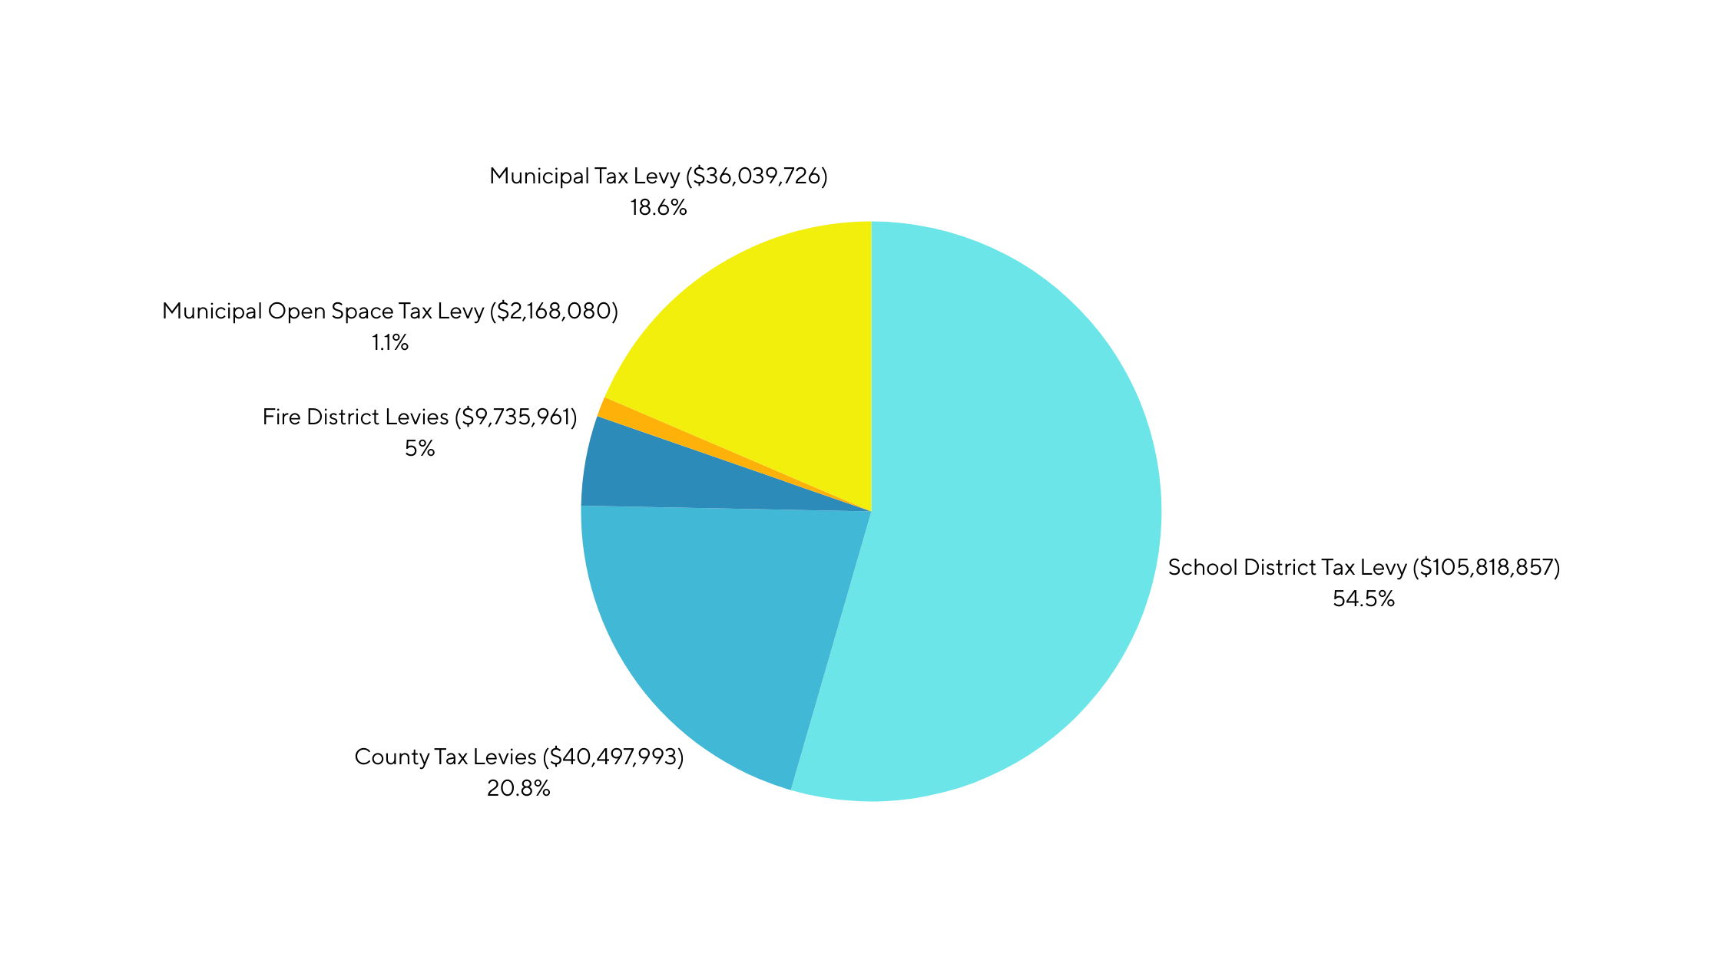
2024 TAX COLLECTIONS
Where Your Taxes Go - $194,260,617 Collected By Township in 2024

Slide 9

MUNICIPAL BUDGET SNAPSHOT
Budget Year | 2025 (Introduced) | 2024 (Actual) | Change | %
Revenues | $58,762,798.00 | $59,567,311.00 | -$804,513.00 | -1.35%
Surplus | $8,900,000.00 | $11,370,000.00 | -$2,470,000.00 | -21.72%
Local Revenue | $6,646,377.00 | $6,176,287.00 | $470,090.00 | 7.61%
State Aid | $3,461,439.00 | $3,811,087.00 | -$349,648.00 | -9.17%
State & Federal Grants | $989,882.00 | $1,120,211.00 | -$130,329.00 | -11.63%
Delinquent Tax | $2,050,000.00 | $1,050,000.00 | $1,000,000.00 | 95.24%
Local Purpose Tax | $36,715,100.00 | $36,039,726.00 | $675,374.00 | 1.87%
Appropriations | $58,762,798.00 | $59,567,311.00 | -$804,513.00 | -1.35%
Salary & Wages | $27,292,383.00 | $26,208,435.00 | $1,083,948.00 | 4.14%
Other Expenses | $15,262,251.00 | $14,438,776.00 | $823,475.00 | 5.70%
Statutory & Deferred Charges | $8,850,362.00 | $10,893,801.00 | -$2,043,439.00 | -18.76%
State & Federal Grants | $1,019,788.00 | $1,274,117.00 | -$254,329.00 | -19.96%
Capital | $200,000.00 | $200,000.00 | $0.00 | 0.00%
Debt Service | $2,872,325.00 | $2,839,355.00 | $32,970.00 | 1.16%
Reserve for Uncollected Taxes | $3,265,689.00 | $3,712,827.00 | -$447,138.00 | -12.04%

Slide 10
WHAT IS A CAPITAL BUDGET?
A Capital Budget is a plan to fulfill the capital needs of the Township for the current and succeeding 5 years. ​
​
It includes roads, police vehicles, equipment, improvements to facilities and land acquisition. It does not include repair or maintenance costs. ​
​
All assets, generally must have a useful life of 5 years. A capital budget helps the municipality spread the cost of these large expenses over a number of budget years. ​
​
A capital budget is not a spending authorization. Funds can only be expended by the adoption of a Bond Ordinance (authorizing debt) or fully funded Capital Ordinance (fully funding projects from available funds on hand.) ​

Slide 11
2025 CAPITAL BUDGET
Narrative For Capital Improvement Program
The Capital Improvement Program presented herewith is an estimated projection of Capital Projects for the next six years. It should be noted that the foregoing does not represent an appropriation of funds for the purposes listed, but merely a plan of capital improvements that are being contemplated in 2025 and the ensuing five years. A funding authorization is required in the form of a budget appropriation or capital ordinance before monies are available for the projects outlined in this section.
Every effort has and will be made by the Mayor and Township Council to plan improvements which are responsive to the needs of the community. Should unanticipated needs arise, the capital program will be revised or amended accordingly.

Slide 12
2025 CAPITAL BUDGET

Slide 13
2025 CAPITAL BUDGET

Slide 14
2025 CAPITAL BUDGET

Slide 15
12/31/24 DEBT CAPACITY
Three-Year Equalized Valuation
$11,498,399,307
Maximum Allowable Debt
Per Statute (3.5%)
$402,443,976
Municipal Net Debt
$23,564,667
Remaining Debt Capacity
$378,879,309

Slide 16
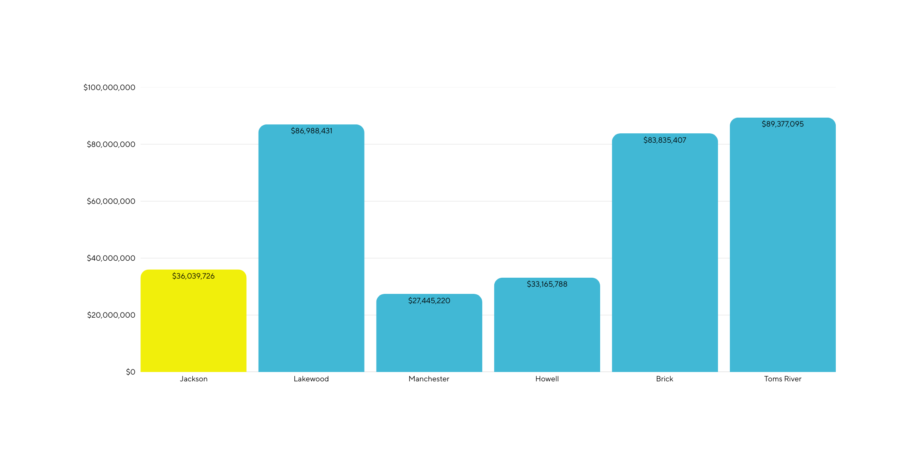
JACKSON VS. NEIGHBORING MUNICIPAL LEVIES (2024)

Slide 17
WHY IS A TAX INCREASE NECESSARY?
  An increase is necessary to maintain the level of services residents have come to expect
  Many cost factors have contributed. Increases in pension, workers' compensation, liability insurance, and public safety far exceed the 2% increase in tax revenues being collected.
  Increased cost of everyday goods and services

Slide 18
2025 BUDGET SUMMARY
  Reassessments do not increase the total amount of revenue to be raised by taxation
  2% Increase of the Municipal Tax Levy, $675,374 in additional revenue generated
  Allows for continued progress towards longer-term Open Space and Capital plans
  2025 proposed municipal tax rate is 0.254 per $100 assessed value
  The 2025 municipal tax levied on an average assessed home valued at $652,896 is $1,661 annually
  To the average homeowner assessed in 2024 at $332,938 and assessed at $652,896 in 2025, they would experience a $1 increase in local purpose municipal taxes

Slide 19


THANK YOU!
Phone
+732-928-1200
Website
www.jacksontwpnj.net

